Slide 1
Neural Networks &
Genetic Algorithms
Bujor Pavaloiu

Slide 2
Content
1. Artificial Intelligence, Machine Learnig, Connectionist paradigm
2. McCulloch & Pitts neuron model. Perceptron
3. Adaptive Linear Neurons
4. Feed-Forward Neural Networks, Backpropagation
5.,6. Deep Learning
7. Competitive learning Kohonen Self-Organizing Networks
8.,9.,10. Genetic Algorithms
Neural Networks & Genetic Algorithms

Slide 3
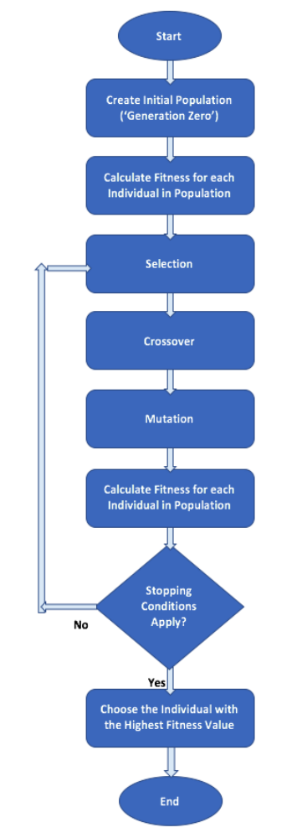
Genetic Algorithm
Neural Networks & Genetic Algorithms

Slide 4
Selection of parents
Selection is done based on the performance/ fitness function - FF
The FF shows how good an individual/ choromosome is at solving the given problem and to participate at the next generation.
It is usually the inverse of the error function for the problem
Not all the selected parents have the same probability to participate to the next generation – the probability is proportional with the FF.
Neural Networks & Genetic Algorithms

Slide 5
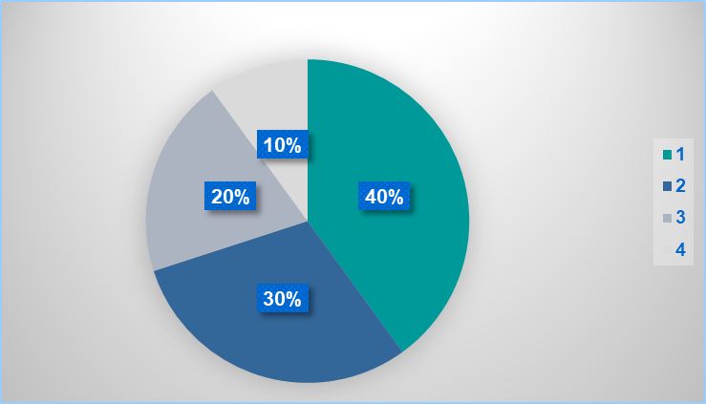
Roulette Wheel Selection
Fitness Function | Cumulated Sum | CS normalized
8 | 8 | 0.4
6 | 14 | 0.7
4 | 18 | 0.9
2 | 20 | 1.0
1
0.9
0.7
0.4
Neural Networks & Genetic Algorithms

Slide 6
Crossover
Crossover, also called Recombination, is a genetic operator used to combine the genetic information of two parents to generate new offspring.
It will generate new individuals, with new genotype, inheriting genes/ traits/ features from both parents.
It is analogous to the crossover that happens during sexual reproduction in biology.
Neural Networks & Genetic Algorithms

Slide 7
Mutation
Mutation is a genetic operator applied toghether with cloning.
Cloning produces genetically identical individuals of an organism and mutation will change the genotype, creating new individuals.
It is similar to the asexual reproduction from biology.
Neural Networks & Genetic Algorithms

Slide 8
Next Generation
Parents are kept usually in the next generation
The fitness function is computed for this new generation and the best fitted individuals (chromosomes) are taken to create the next generation.
This procedure makes GA a heuristic search method.
Neural Networks & Genetic Algorithms

Slide 9
Genetic representation
GAs operate on the solutions representation (or encoding), often referred to as chromosomes.
There are several types of encoding
  Binary encoding, where the chromosome is an array of bits.
  Value/Real Encoding, where the chromosome is a array/vector of real numbers
  Permutation encoding, where the chromosome is a permutation
  Tree encoding, where the chromosome is a tree
Neural Networks & Genetic Algorithms

Slide 10
Binary Encoding
The chromosome is an array of bits:
Crossover means changing bits between the parents
Chr. A | 0 | 0 | 1 | 1 | 0 | 1
Chr. A | 0 | 0 | 1 | 1 | 0 | 1
Chr. B | 1 | 0 | 1 | 0 | 1 | 1
Chr.M | 0 | 0 | 1 | 0 | 0 | 1
Chr.N | 1 | 0 | 1 | 1 | 1 | 1
Neural Networks & Genetic Algorithms

Slide 11
Binary Encoding
Mutation means changing bits belonging to a chromosome.
Chr. A | 0 | 0 | 1 | 1 | 0 | 1
Chr.M | 0 | 1 | 1 | 1 | 0 | 0
Neural Networks & Genetic Algorithms

Slide 12
Value Encoding
The chromosome is a real number or an array of numbers.
Crossover is done usually by a weighted sum of the genes (numbers in the array) between the parents.
Mutation is done usually by changing randomly the genes in a given radius.
It should be taken care that the reproduction operation is consistent – the offspring is a valid permutation.
Neural Networks & Genetic Algorithms

Slide 13
Value Encoding
Mating
Mutation
Chr. A | 1.2 | 1 | 3 | -3.1 | 1 | 2
Chr.B | 1 | -2 | -1 | 2 | 0.1 | 0
wa=0.75
wb=0.25
Chr.B | 1.15 | 0.25 | 2 | -1.825 | 0.775 | 1.5
Chr.B | 1.2 | 1 | 3 | -3.1 | 1 | 2
R=.1
Chr.B | 1.2113 | 0.965 | 3.367 | -3.012 | 1.074 | 2.123
Neural Networks & Genetic Algorithms

Slide 14
Permutation Encoding
In permutation encoding, every chromosome is a permutation of the integers from 1 to N.
It can be used in ordering problems, such as Travelling Salesman problem or task ordering problem.
Mutation is done by swapping two elements from the permutation order.
Chr. A | 4 | 3 | 6 | 2 | 1 | 5
Chr. A | 4 | 1 | 6 | 2 | 3 | 5
Neural Networks & Genetic Algorithms

Slide 15
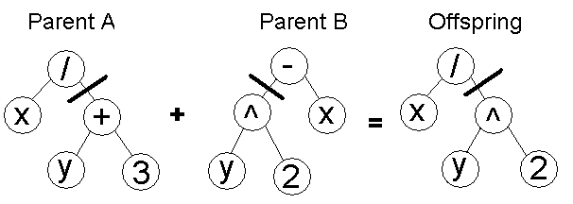
Tree Encoding
Trees are used in genetic programming to represent relations and expressions
Neural Networks & Genetic Algorithms

